Slide 1
CALCULATOR USING GITHUB
TEAM-
1. PRASHANT BHUNAL- HIMACHAL PRADESH
2. RAHUL THAKUR- HIMACHAL PRADESH
3. NAMAN JAIN- DELHI

Slide 2

GIT HUB

Slide 3
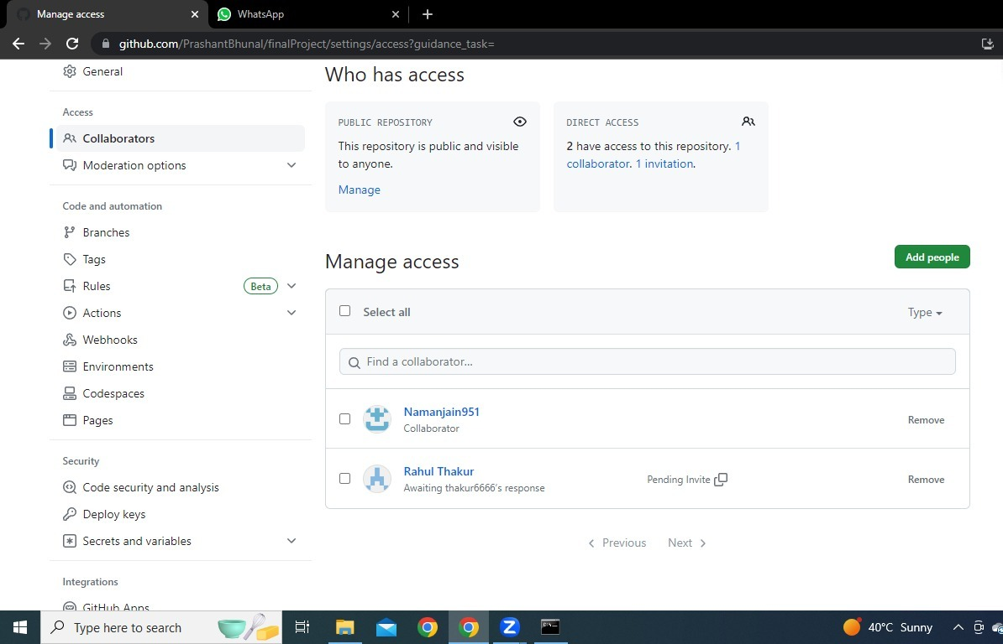
SHARING OF FILES
COLLABORATION FEATURES OF GIT HUB

Slide 4
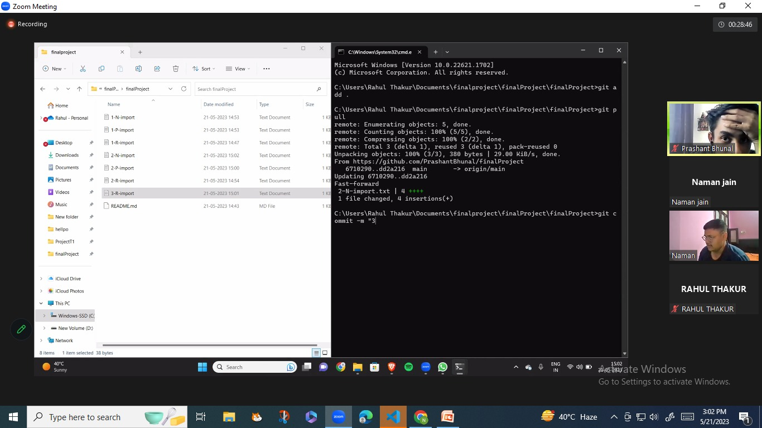
Exchanging Of Codes

Slide 5
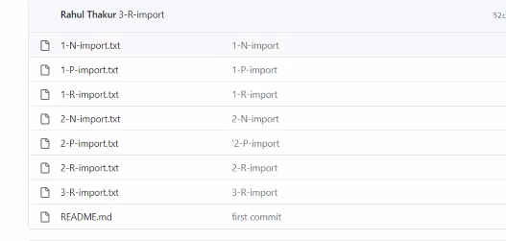

Slide 6
Using Of Commands
Git clone – For Cloning The Repository in other machines
Git add . – For adding a files and folders in directory
Git commit – For committing the added file
Git push – For uploading the file from local repository to master repository
Git pull – For Extracting the files to the machines.
Git status – For viewing the status of files in repository

Slide 7
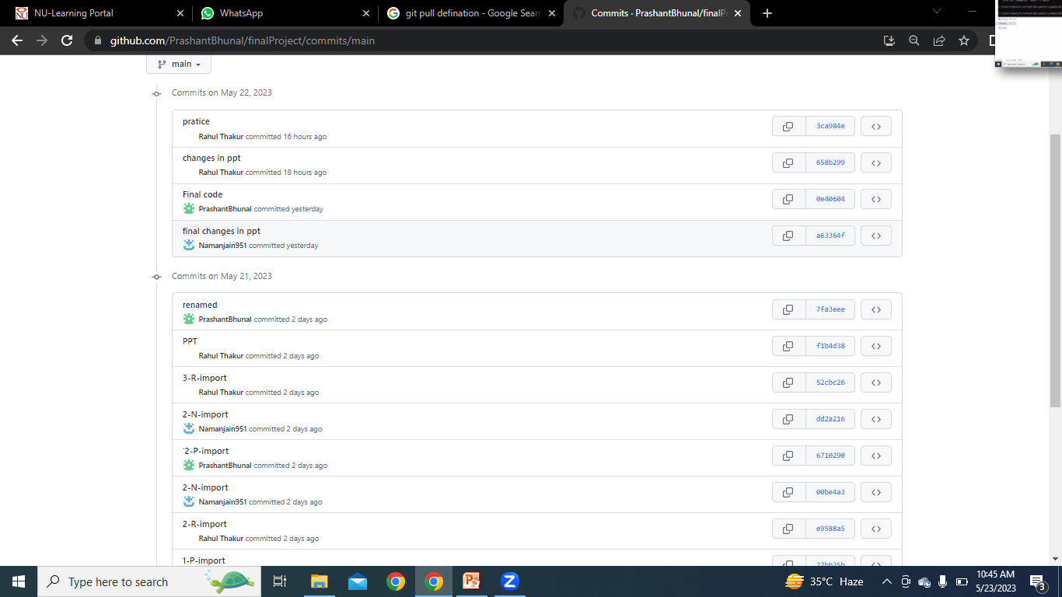
Commited Files and folders

Slide 8
Use Of Git Push And Git Pull
Git Push
Git Pull
For uploading the file from local repository to master repository.
Used to fetch and download content from a remote repository and immediately update the local repository to match that content

Slide 9
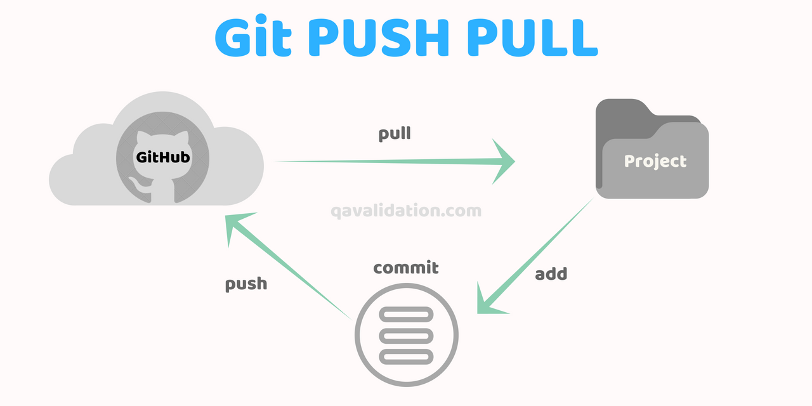




Slide 10
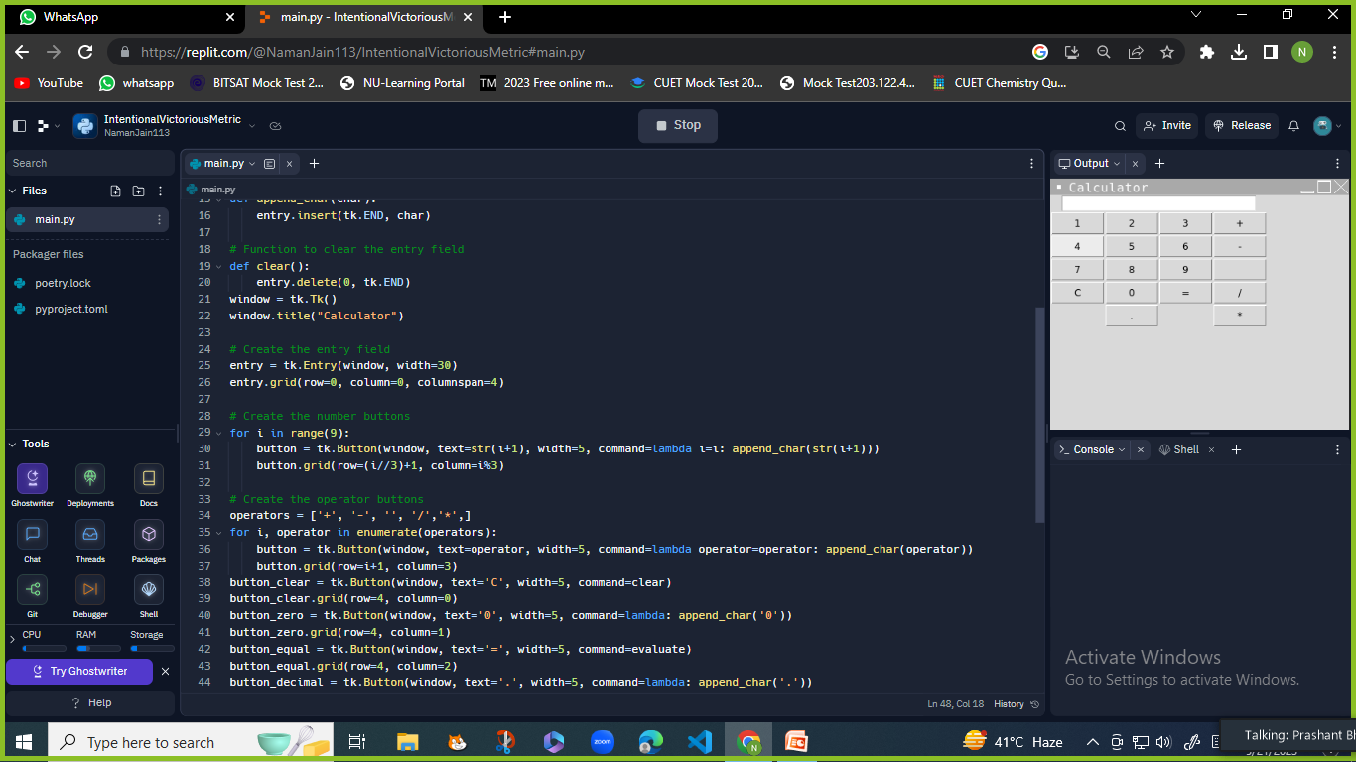
Python Codes For Calculator
**

Slide 11
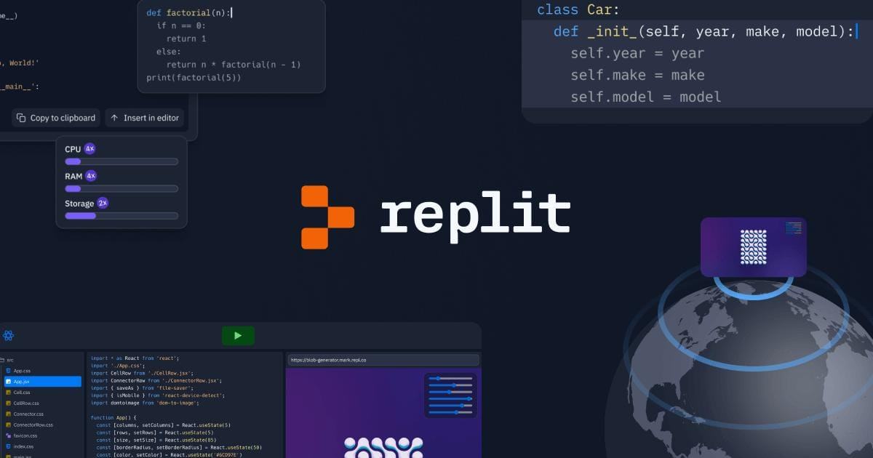
Use Of Code Editor

Slide 12
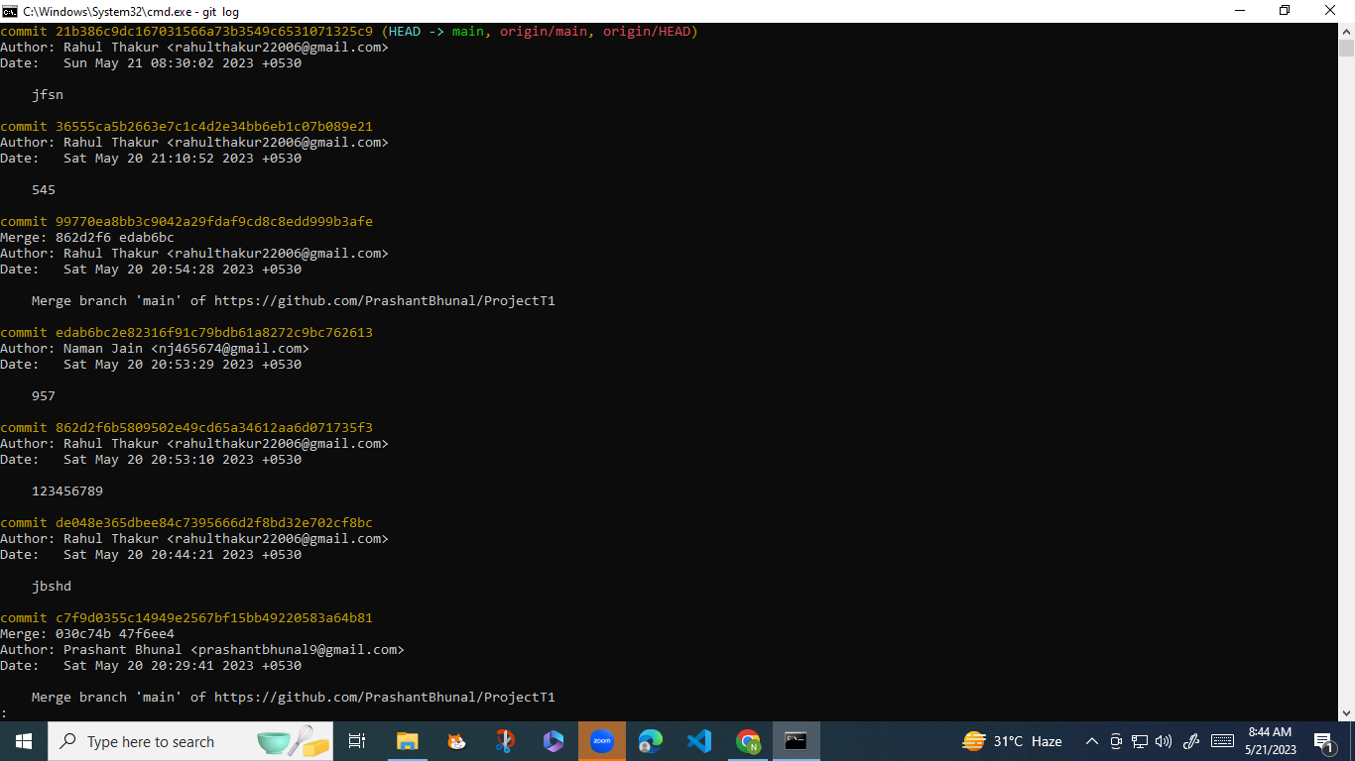
How To Use Checkout And Log Command

Slide 13
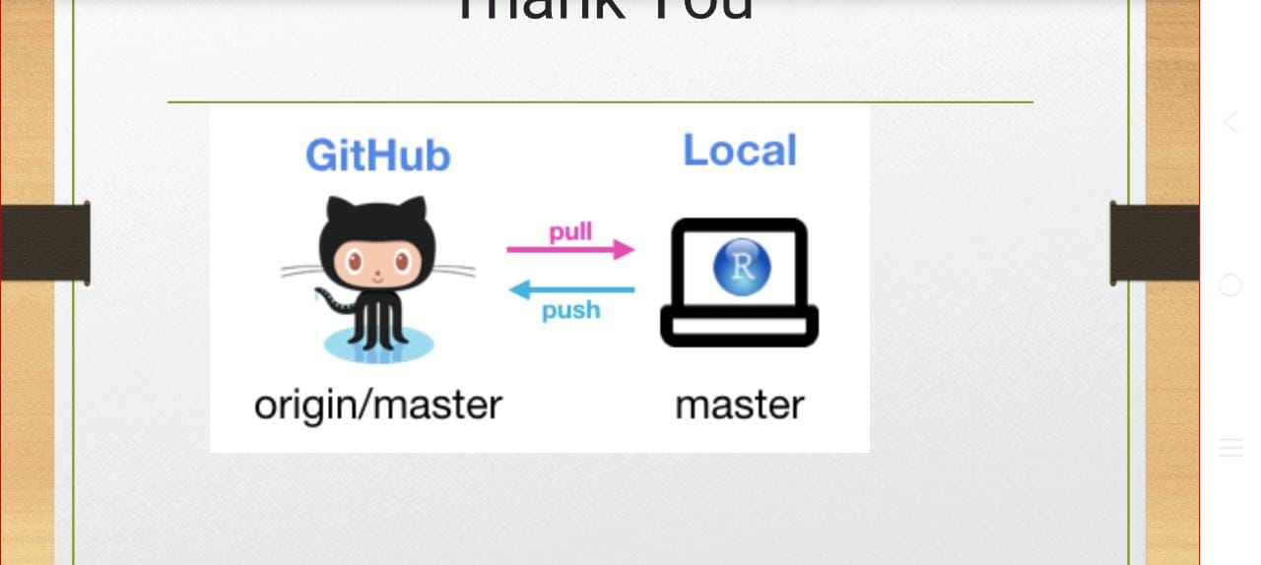
Thank You NIIT UNIVERSITY

